Slide 1
Adaptive Pooling Padding
David Gormley, Veer Bathwal

Slide 2
Review: Why do we have to pad?
PyTorch data loaders feed images to our network in batches. This allows us to benefit from parallel processing (based on num_workers input)
Create groups of size = batch_size, that are all fed into the model at once, before each new backpropagation update
Images in each batch have to be the same size, however different batches can have different sizes
This is a problem if we’re using adaptive pooling instead of resizing all images
As a result, we have to pad images in each batch up to the width of the largest image in that respective batch

Slide 3
Review: Bucketing logic
Since we are padding images up to max width within each batch, we want to group together images of similar size (into “buckets”) in order to minimize the amount of padding that is done
This is what the BucketSampler and make_boundaries_for_batches functions in the skeleton code do
So what is the optimal number of buckets in order to minimize padding?

Slide 4
Bucketing vs Batching
A batch is simply the group of images put together by the data loader, which is ultimately fed into the model
A bucket is just a term we came up with, it is not defined terminology
If we divide our images into 2 subgroups based on size, we say we have created 2 buckets
Each batch is formed from one particular bucket
Our hypothesis is that plugging number of buckets = number of batches is the optimal solution, since each bucket simply then becomes a batch
We can calculate number of batches as (num of images/batch_size)
Since number of images may differ across train, test, and validation sets, we may have to use different number of buckets across our 3 data loaders

Slide 5
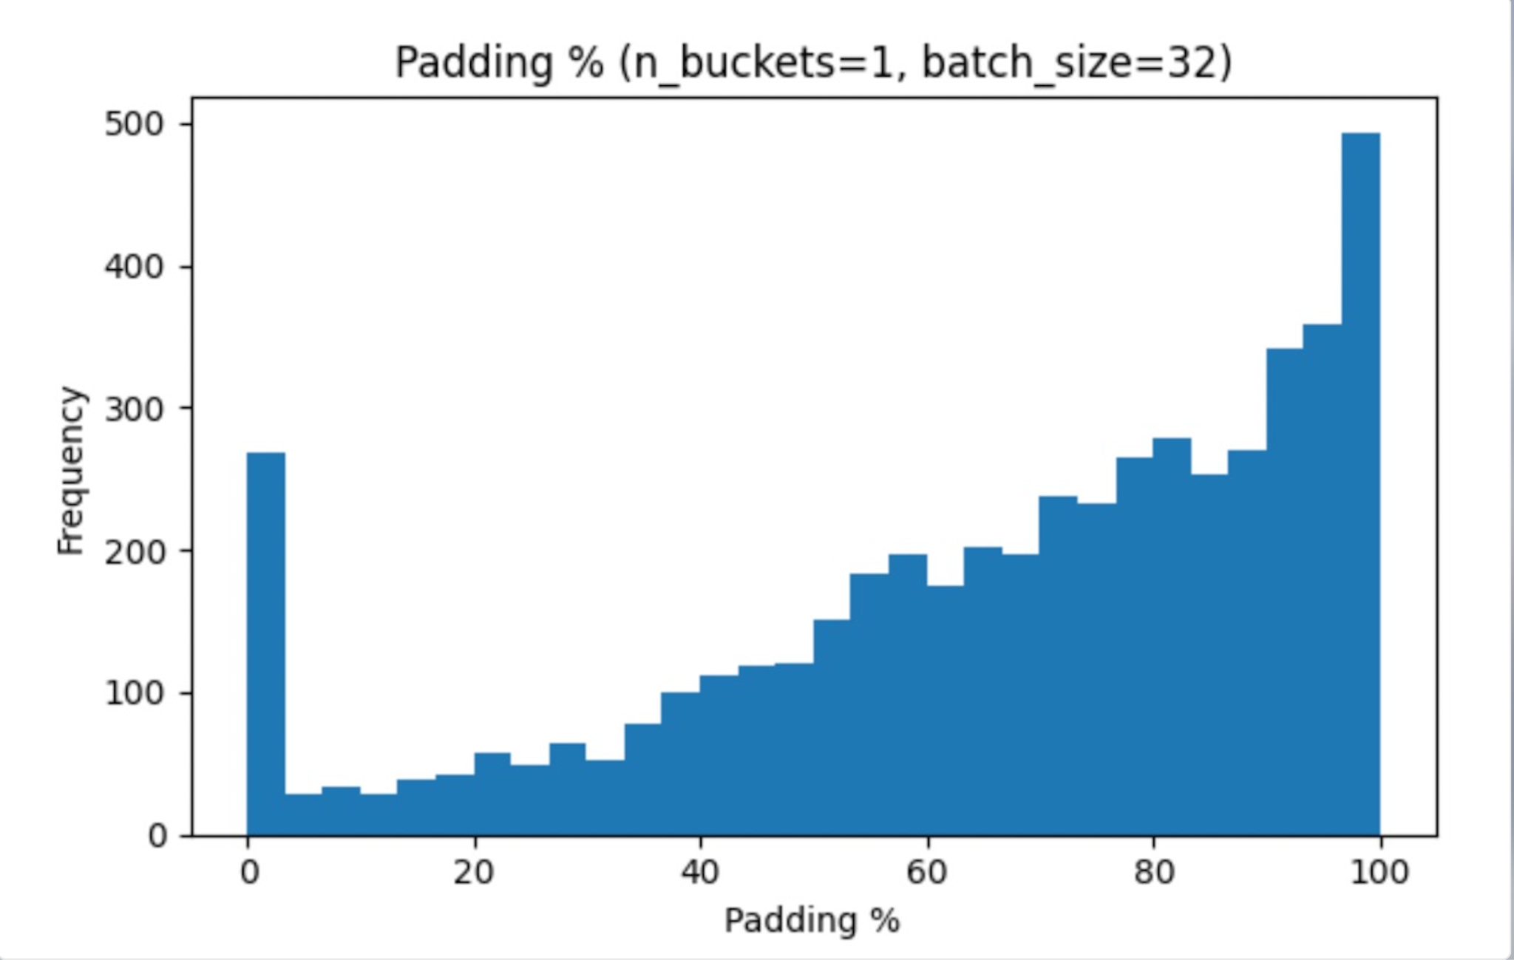
Not doing any grouping results in excessive padding

Slide 6
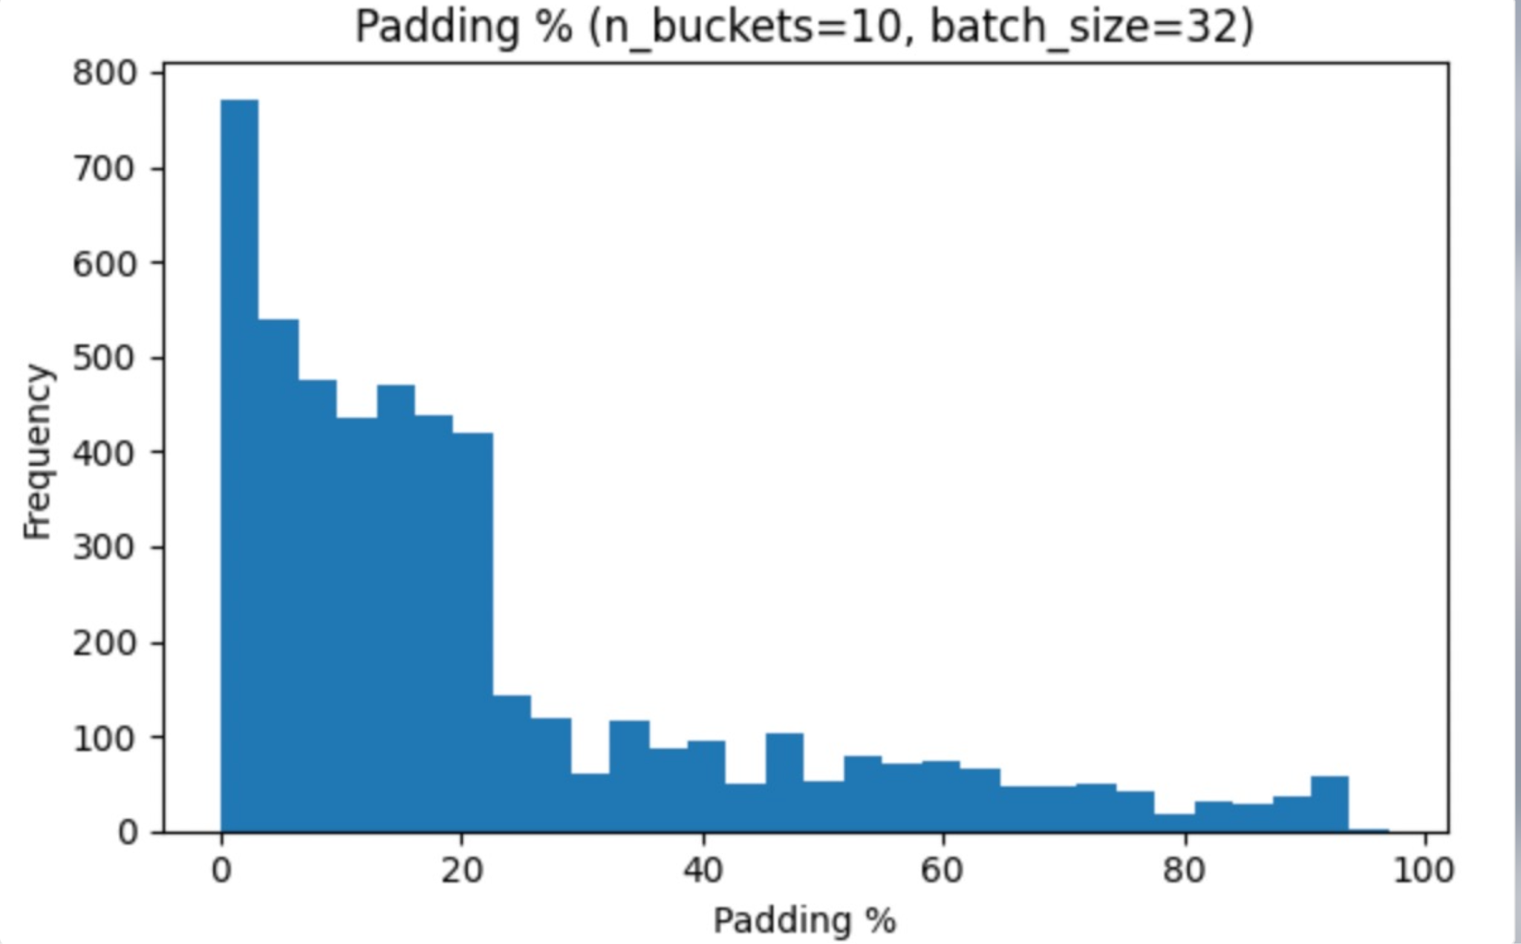
Increasing number of buckets gives better results

Slide 7
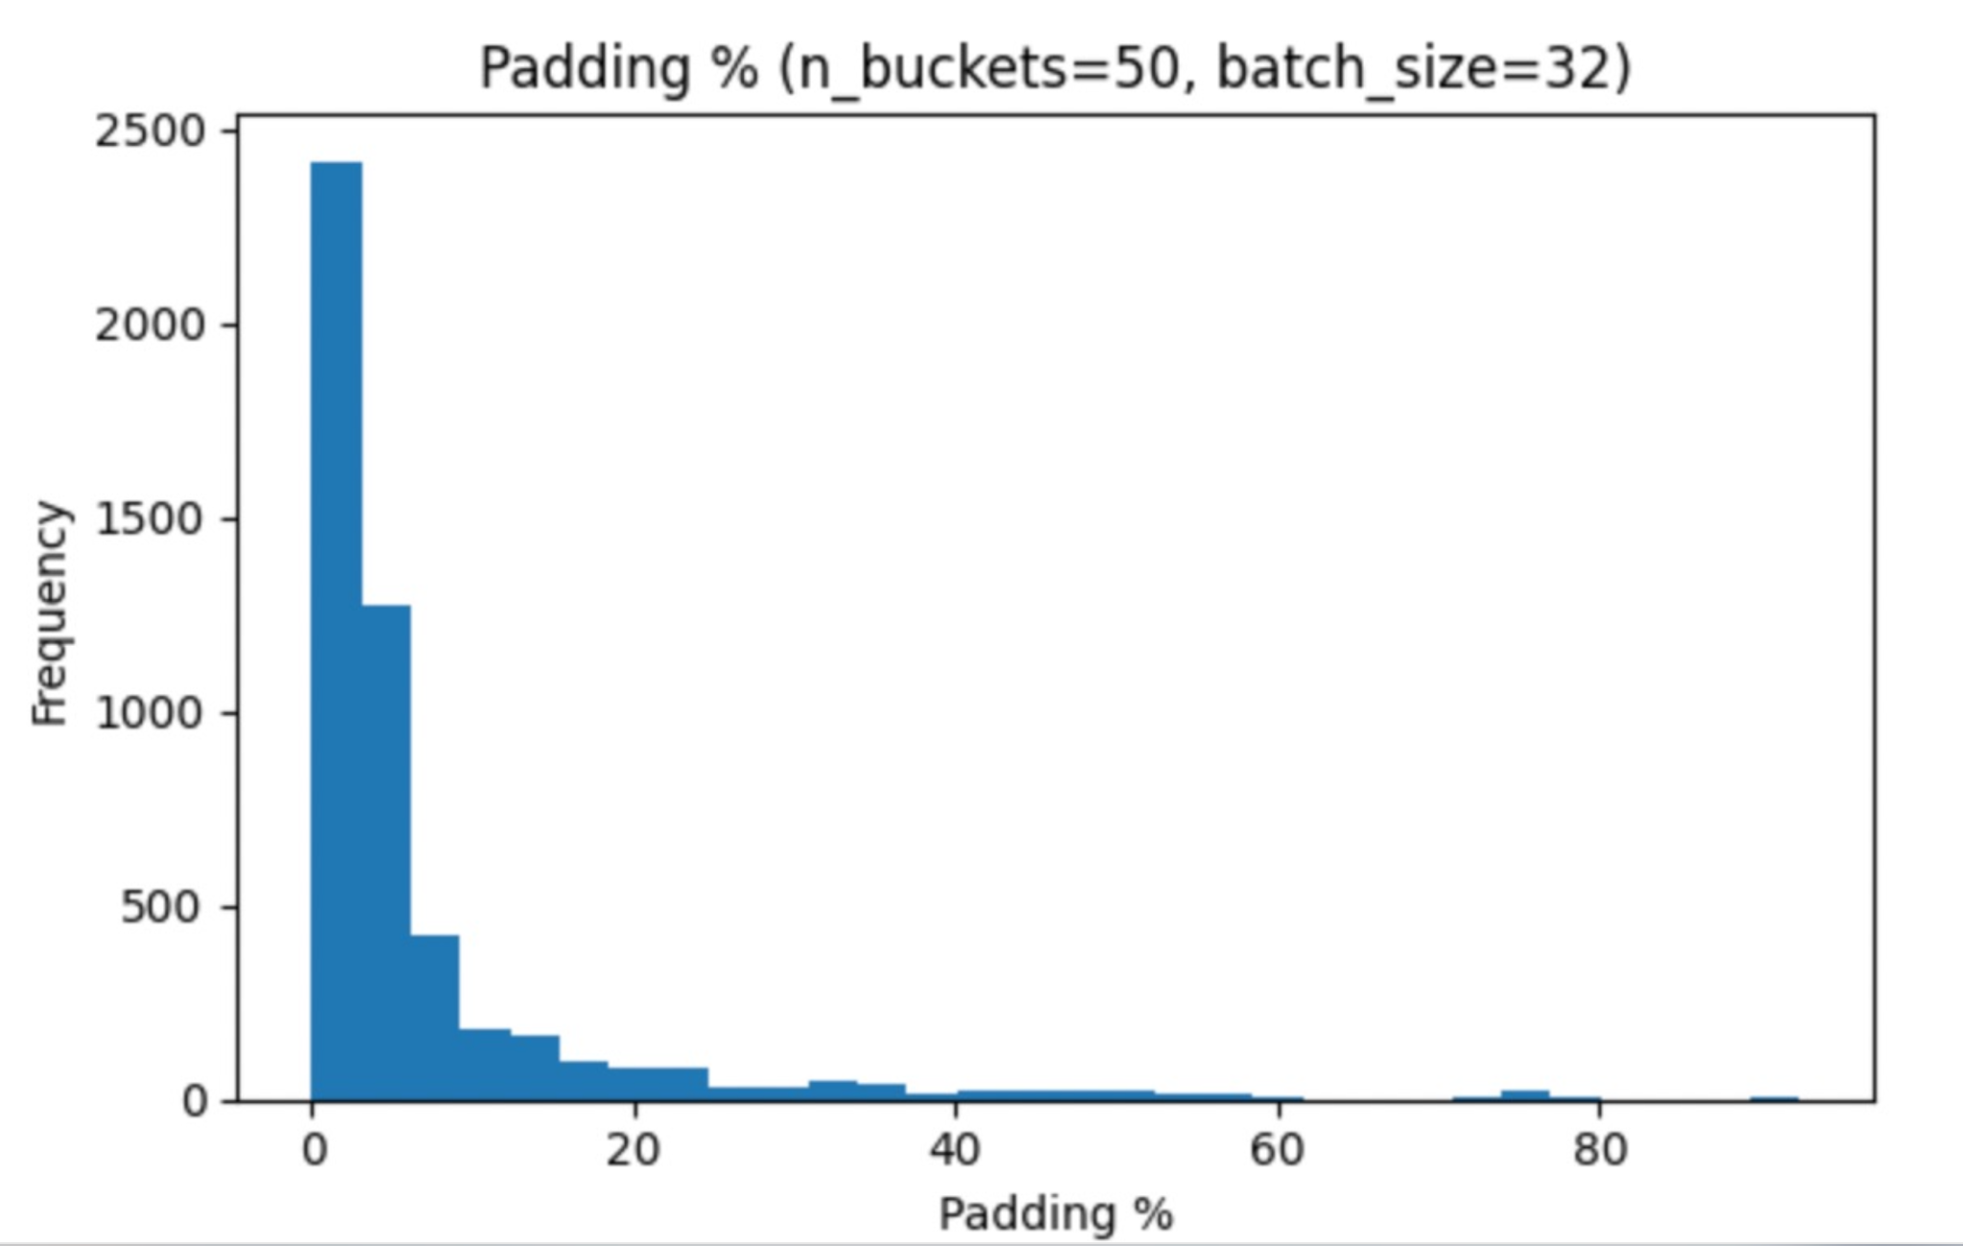
Increasing number of buckets gives better results

Slide 8
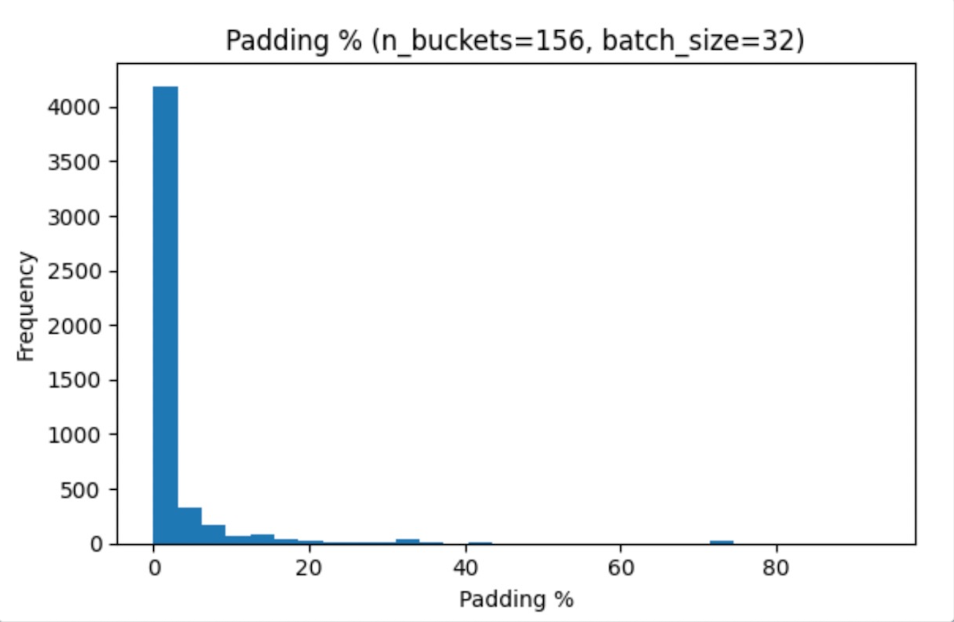
Increasing number of buckets gives better results

Slide 9
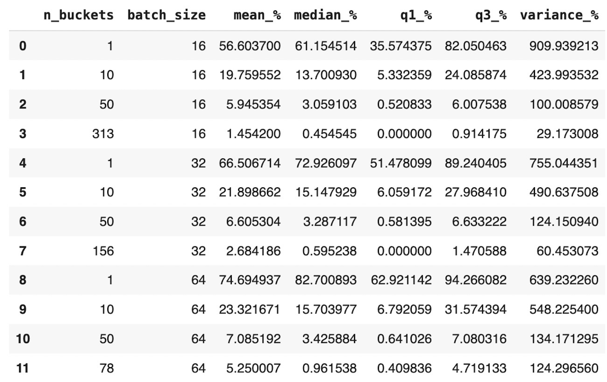
Summary stats across batch size and number of buckets

Slide 10
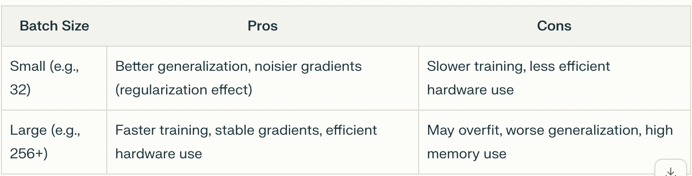
Impact of Batch Size as a Hyperparam (from perplexity)

Slide 11
Takeaways
Lower batch size and higher number of buckets will reduce padding
However, this comes at the trade-off of higher computational cost. A smaller batch_size means the data loaders has to create more batches, which means a longer runtime for our training loop
Furthermore, num_buckets cannot be larger than number of batches, since each batch is taken from a single bucket
Our suggestion: use batch_size = 16 or 32 and keep number of buckets = number of batches
Where number of batches = number of images/batch_size
Since number of images differs across train, test, and validation sets, we will have to use a different number of buckets for each
This can be setup in the skeleton code’s config, as shown in the updated code for this week

